Slide 2
The Integrated Ultrasound Curriculum
Didactic classroom lectures
Web-based learning modules and interactive exercises
Scheduled hands-on laboratory scanning sessions
Open ultrasound laboratory practice sessions
Web-based image portal for review and archiving
Phantom and simulator learning and assessment
Integration of ultrasound into anatomy, physiology, pathophysiology, pathology, problem-based learning, physical diagnosis, and clinical clerkships

Slide 3
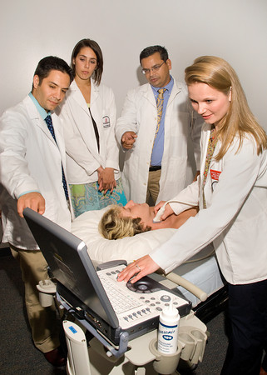

Slide 4
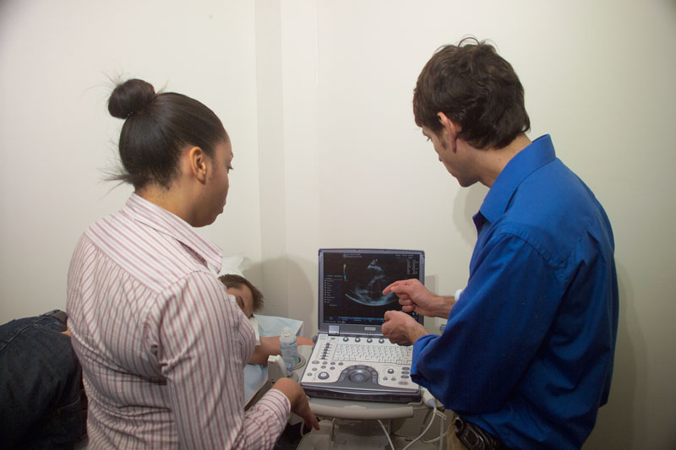

Slide 6
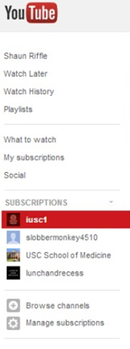
http://www.youtube.com/iusc1
U of SC Ultrasound Institute Channel

Slide 7
M1 Student Practical Exam Fall Semester
All first year students are individually evaluated for their ability to scan a standardized patient. They were also evaluated by an observer regarding their interaction with the standardized patient and attentiveness to patient comfort and modesty.
Each student had 15 minutes to capture, identify structures and save the images.

Slide 8
Images
RUQ Pelvis LUQ Neck
Rt Kidney Bladder Lt Kidney Carotid Artery
Liver Spleen Internal Jugular Vein
Diaphragm
M. pouch
Parasternal Long Axis Heart
Lt Atrium
Lt Ventricle
Mitral valve

Slide 9
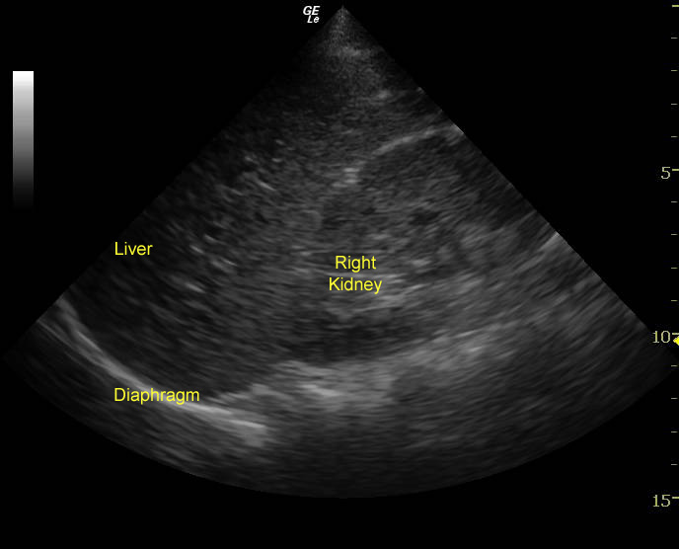

Slide 10
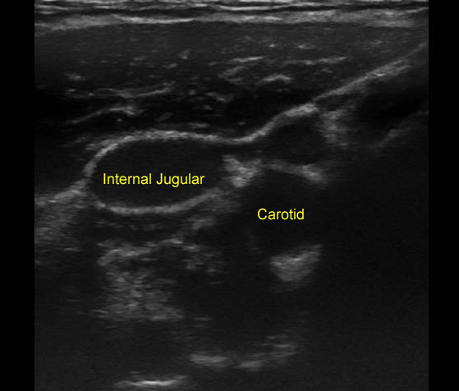

Slide 11
Results of M1 Practical
All students easily completed the exercise within the allotted time of 15 minutes.
Maximum possible score for the OSCE = 50 points
Mean score for the class = 49.1 points
Range for the class = 39.0 - 50.0 points
Students with a perfect score of 50.0 = 78%

Slide 12
Physiology Ultrasound Labs
Hemodynamics lab: Doppler principles, pulse wave forms (venous / arterial systems)
Cardiac lab: normal heart function (4-chamber apical view). Wall and valve motion; flow through the cardiac chambers, Color Doppler, spectral analysis
Cardiac lab: ECHO plus EKG, dynamic cardiac motion and electrocardiagram, pressure waves
Cardiogenic Shock: gross LV/RV function, pericardial effusion, RV strain from a PE

Slide 13
Enlargement of Internal Jugular Vein with Valsalva

Slide 15
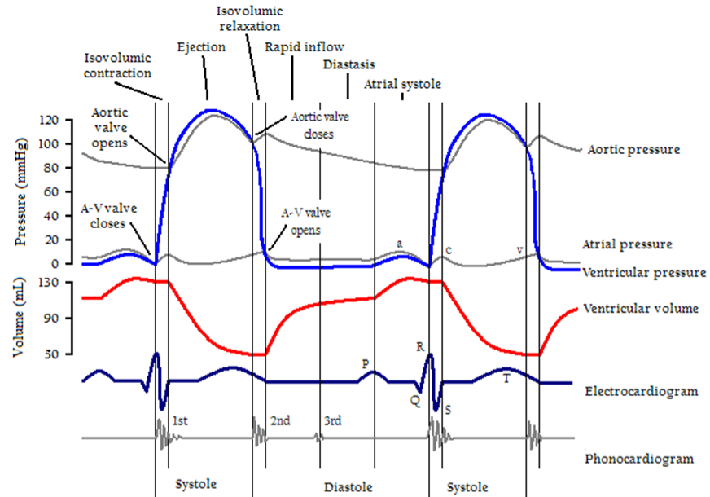
Wigger’s
Diagram

Slide 16
M2 Ultrasound Curriculum: Coordinated with Physical Diagnosis, Pathology, and Pathophysiology
Focused ultrasound examinations, clinical scenarios, and ultrasound guided procedures
Cardiac views: parasternal long and short axis, 4-chamber apical, subcostal
Abdomen: organ size, abdominal fluid, AAA screen
Vascular: DVT screen, IVC and volume status, central line placement
Neck: thyroid, carotid, and jugular exam
Pelvic ultrasound (female gynecology)

Slide 17
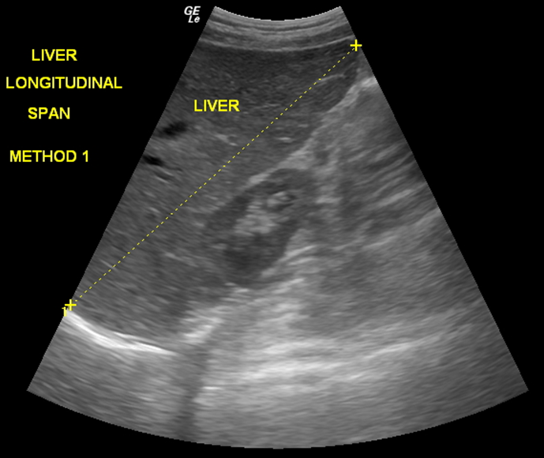
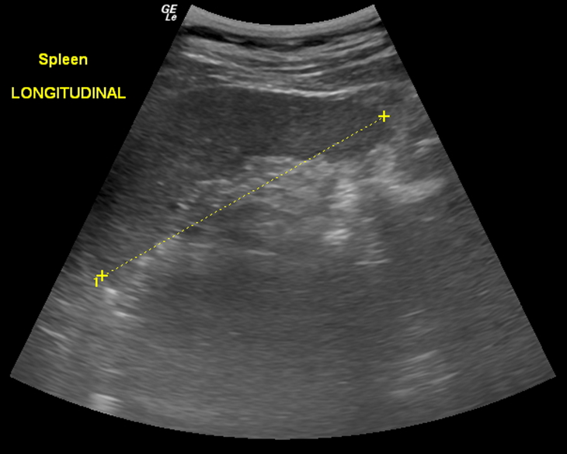
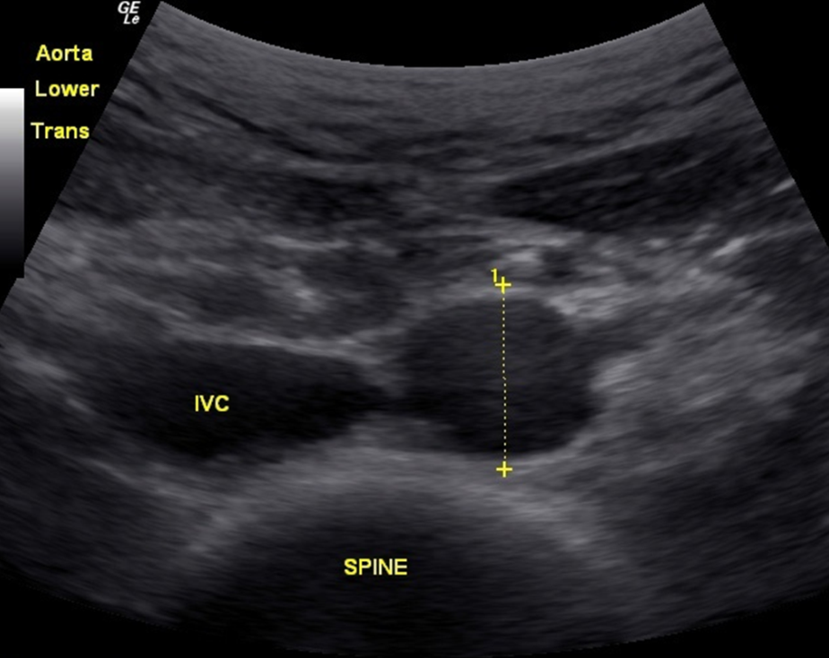

Slide 18
Small group pathology teaching sessions: clinical cases are presented, including patient history, physical exam findings, laboratory data, and ultrasound images.

Slide 21
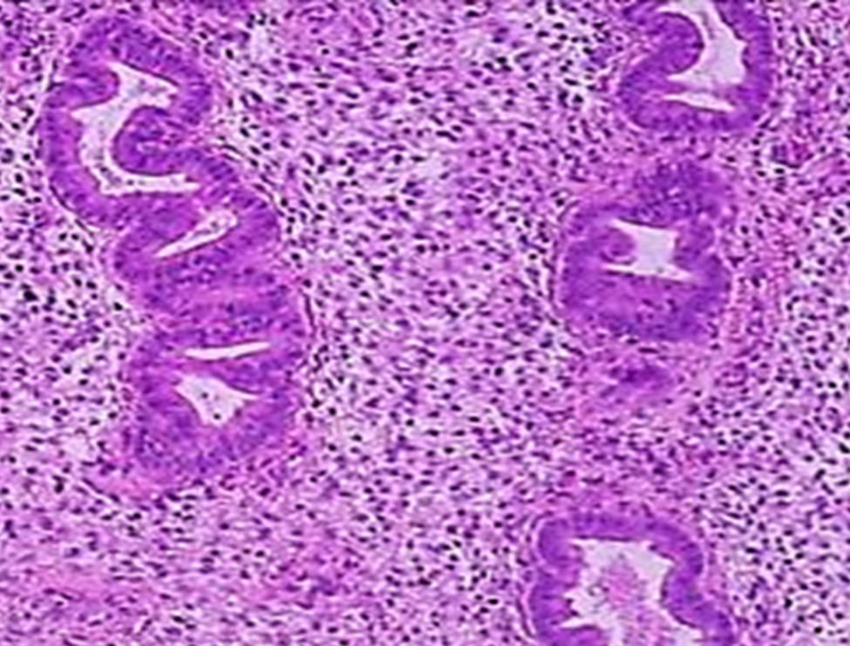
Endometrial Cycle
Proliferative Endometrium
Proliferative Endometrium
Slides courtesy of
Dr S. Goldstein
Post Menstrual Endometrium

Slide 22
Fetal Heart Activity
Slide courtesy of Dr J. Pellerito

Slide 23
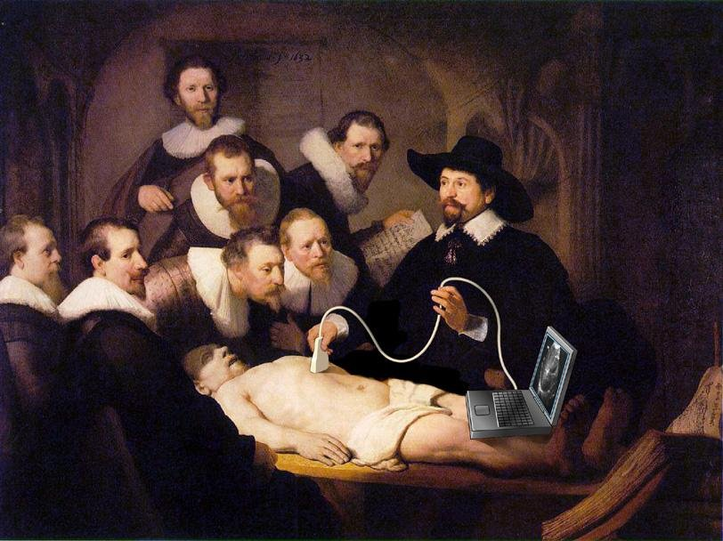

Slide 24
Physical Diagnosis Ultrasound as an Extension of the Physical Exam and a Teaching Tool

Slide 25
Abdominal Examination

Slide 30
Liver Descending on Inspiration

Slide 31
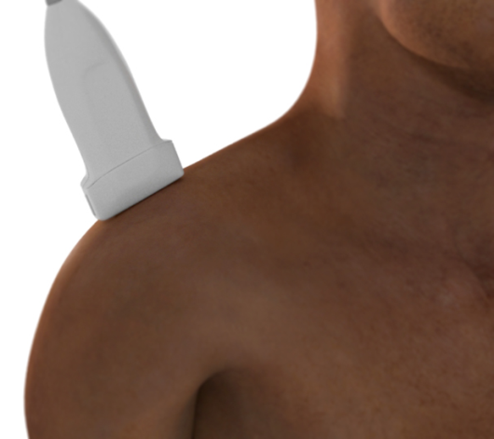
Supraspinatus Sliding Under the Acromium on Abduction
SUPRASPINATUS
ACROMIUM
DELTOID
HUMERUS

Slide 32
Combining Ultrasound with Physical Examination Sounds

Slide 33
Murmur of Aortic Insufficiency

Slide 34
AI Murmur with Color Doppler

Slide 35
Crackles of Pulmonary Fibrosis on Inspiration

Slide 36
Comparison of Hand-Carried Ultrasound to Bedside Cardiovascular Physical Examination. Kopal SL, et al. Am J Cardiol 2005
Two first year medical students
4 hrs of lecture and 14 hrs of hands-on experience
Students outperformed 5 board-certified cardiologists in identifying cardiac pathology in 61 cardiac patients
Students identified 75% of the pathologies and cardiologists identified 49%

Slide 37
Third Year (M3) Students
Clerkship directors have introduced ultrasound into the clerkship curriculum and OSCE evaluations
Ultrasound in the ICU: 2 week block on IM
Heart sounds and ECHO sessions on IM clerkship
Pocket ultrasound has been added to the IM, FM, and Peds clerkships
An ultrasound station has been added to the end-of-year Gate OSCE

Slide 38
M3 Clerkship OSCEs
Internal Medicine:
thyroid scan
central line placement with ultrasound guidance
Family Medicine:
Abdominal Aortic Aneurysm (AAA) screen
OB/GYN:
third trimester pregnancy with bright red vaginal bleeding - transabdominal scan
Pediatrics:
Assess volume status of a 9 year old
Surgery:
Trauma patient – FAST exam

Slide 39
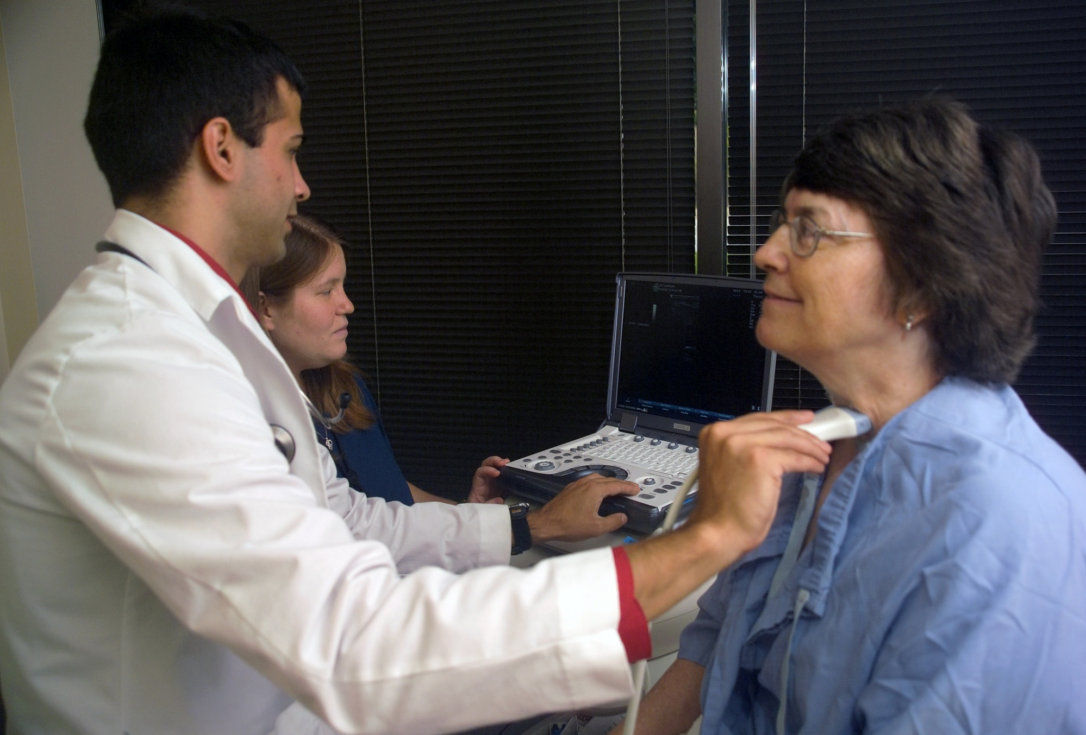

Slide 40
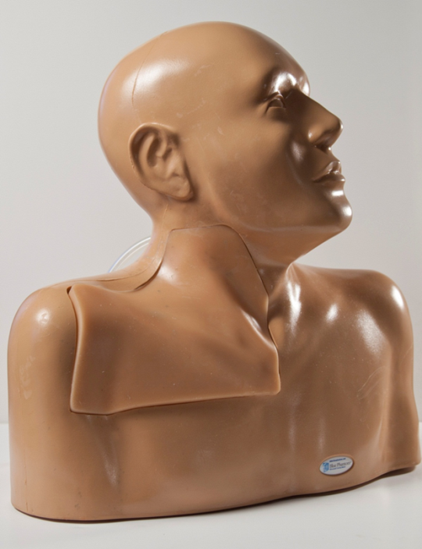
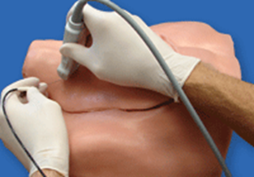
Phantoms and Task Trainers

Slide 41
Ultrasound Guided Central Line Placement in a Phantom

Slide 42
Fourth Year (M4) Students
Four week Emergency Medicine Ultrasound Elective
Hands-on ultrasound experience added to Radiology Elective
Two day Capstone course to prepare for residency: FAST for trauma, RUSH for shock, ultrasound guided procedures
Ultrasound Independent Study: research, further develop US skills, help with M1/M2 labs

Slide 43
Student Review Portal and Archive

Slide 45
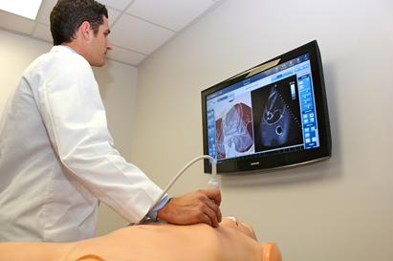
Ultrasound Simulation

Slide 46
Four Component E-portfolio
Web-portal archived and evaluated images from scanning labs and clinical rotations
Interactive online learning and assessment activities plus standard examination questions
Simulation and phantom task-trainer activities
Observation and assessment of knowledge, skills, and behaviors – OSCEs (some video recorded) and clinical evaluators’ assessments

Slide 47
JAMA 1909;53(7):560-561
JAMA
The Journal of the
American Medical Association
THE CROWDED MEDICAL CURRICULUM
During the past year one of the most important subjects of discussion has been the crowded medical curriculum. There are so many subjects in the curriculum of medical schools that it is difficult for students to get clear ideas with regard to them. This overcrowding is becoming worse every year in spite of all that has been done.

