Slide 1
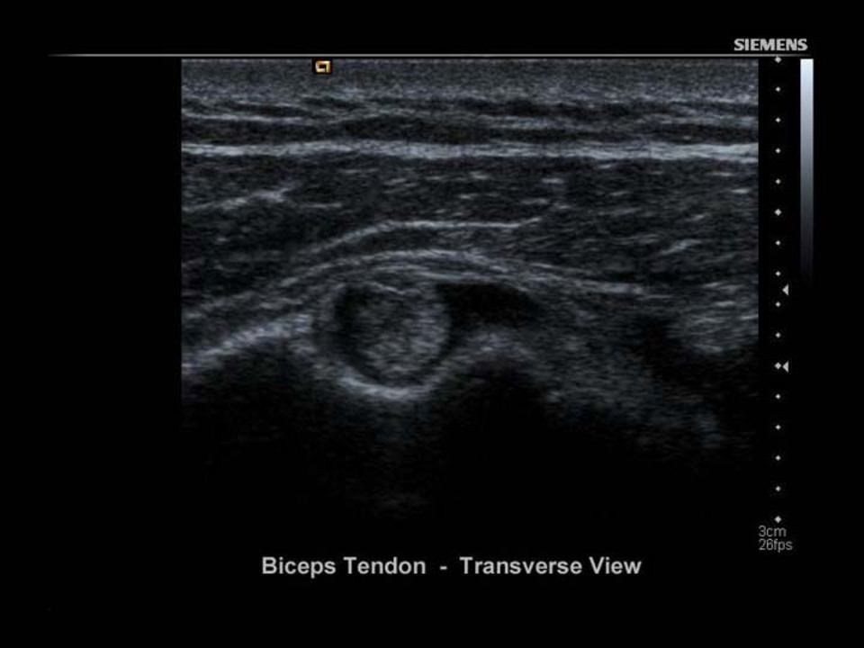
MSK #2: Shoulder

Slide 2
Goals
Understand the structure-function relevant to pathology for the shoulder joint.
Demonstrate key clinical applications of ultrasound in the diagnosis and management of shoulder pathology.

Slide 3
Learning Objectives
Identify and label anatomical components and relationships in the shoulder (head of the humerus, greater and lesser tubercle, bicipital groove, rotator cuff tendons, glenoid, acromion, AC joint, capsule, cartilage of AC joint, labrum).
Differentiate MSK tissue types under ultrasound (tendon, bone, nerve, skin, muscle, blood vessel, and fat).
Recognize and create ultrasound artifacts.
Demonstrate maneuvers and physical exam of the shoulder.

Slide 4
Learning Objectives
Compare and contrast the presentation of dislocations, rotator cuff injury, occipital tendinitis, frozen shoulder, bicipital tear, and age related degeneration.
Correlate the ultrasound presentation to LO5 and LO6.
Perform an ultrasound guided joint injection.
Documentation, labeling, and image archival.

Slide 5
Clinical
Structure
LO | MS1/MS2 | MS3/MS4 | GME | CME
1 | Essential | Essential | Essential | Essential
2 | Essential | Essential | Essential | Essential
3 | Desirable | Essential | Essential | Essential
4 | Desirable | Essential | Essential | Essential
5 | Desirable | Essential | Essential | Essential
6 | Optional | Desirable | Essential | Essential
7 | Optional | Optional | Desirable/Essential | Essential
8 | Essential | Essential | Essential | Essential

Slide 6
Taxonomy
 | Small group | Large group
Early Learner | MS1 and MS2 Group < 50 | MS1 and MS2 Group > 50
Late Learner | Residents and Faculty Group < 20 | Residents and Faculty Group >20

Slide 7
Early large group
Audience response
Pre-work with basic understanding of Anatomy &Physiology
Patho-anatomy
Case-based questions
SP guided
Physical Diagnosis (tied back to A&P)
Ultrasound basics
Ultrasound clinical procedure

Slide 8
Assessment
Assessing students in break-out groups, possibly as a practical assessment

Slide 9
Early Small Group(4-6)
In-Lab (~30 min)
Basic US knowledge in large-group session
Use US on students to identify anatomical structures
Independent study (week-long)
Case based learning with a different case for each group
Use patient presentation, physical exam, and US to diagnose and explain the anatomical pathology
Present findings to the entire class in a facilitated discussion (10-15 min presentation)

Slide 10
Assessment
Formative feedback on images and presentation
Summative assessment in written/oral exam.

Slide 11
Late large learner (framing)
Base knowledge assumed
Large group lecture hall with SPs, pathology patients, and phantoms
Creating patient record
Documenting in the EMR
Faculty demonstration of MSK shoulder exam
Students to identify pathologies using audience response system
Demonstrate and document artifact, dynamic exam, and pathology
Injection and document demonstration
Use phantoms

Slide 12
Assessment
Documentation and record review by overseeing faculty of captured images

Slide 13
Small Late Learners (10-15)
Pre-work to review anatomy and pathology
Subsequent to large late learner
Regular patients
4 half-day sessions over 2 years with:
1st session: Normal physical exam correlated with US
2nd: Pathology correlated with ultrasound
3rd: Formative assessment – identify patient diagnoses (rotator cuff tears, bursitis, capsulitis, bicipital tendonitis, effusion)
4th: Injection in patients

Slide 14
Assessment
Formative evaluation with patients
Review archived images

